Slide 1
Prevention and Response to Terrorism for SBLE
Instructor

Slide 2
“He who protects everything, protects nothing.”
Sun Tzu: The Art of War
Notes:
Instructor Notes: Open the class by asking what this ancient quote might have to do with the concept of protecting schools.
Point out that we can cover schools in an iron dome or force filed and can’t stop every action that may cause harm, but we can use resources in a planned, informed, intelligent manner to detect, deter, delay, and defeat possible terrorist actions against our schools.

Slide 3
Terminal Objective: Part I
Participants will recognize the threat posed by terrorist organizations to American schools and identify actions they can take to help school communities be prepared to detect, deter, delay, and defeat such attacks.

Slide 4
Enabling Objectives
Recognize the threat posed by terrorist organizations (foreign and domestic) to American schools
Describe the types of terrorist threat and the structure of the organization
Discuss the four types of Strategic-Level Terror Attacks

Slide 5
Enabling Objectives
Describe and discuss the terrorist attack on Beslan, Russia, School No. 1 in September 2004
Identify the need to prepare for a terrorist attack similar to Beslan
Describe the tactics that can be used against schools and the role SBLE can play in detecting and disrupting the threat
Identify actions an SBLE can and should take to prepare their schools for this threat

Slide 6
What Can We Do?

Slide 7
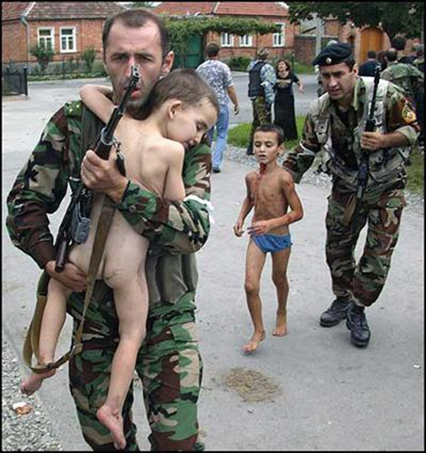
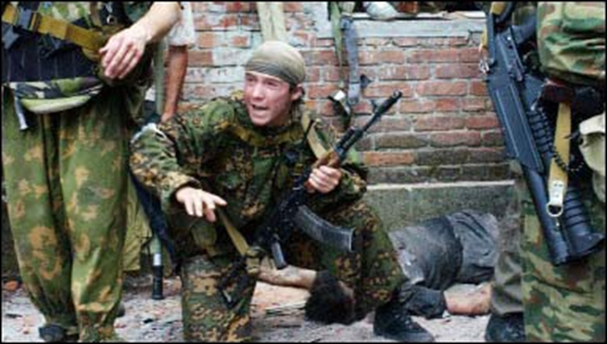
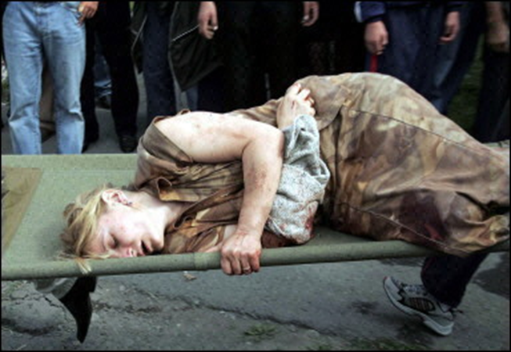
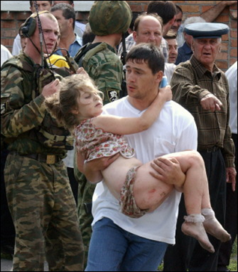
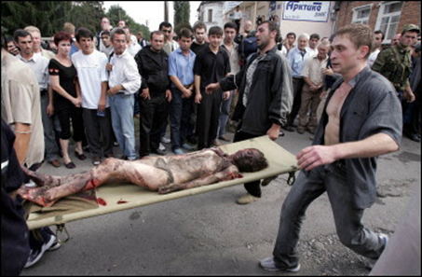
Why Must We Do It?

Slide 8
“The first problem is not what we do when the bad guys get into the classroom, but rather how we keep them out in the first place.”
“Once the bad guy gets into the classroom, we are left with nothing but bad options.’
- Lt. Col. Dave Grossman

Slide 9
http://www.obsessionthemovie.com/trailer.php
Notes:
The instructor will show the provided movie clip –Obsession. (Back-up Hard Copies on Order)
ALERRT providing embeddable copies.

Slide 10
Prevention and Response: Acts of Terrorism on Campus
Part 1: Understanding the Threat

Slide 11
Terrorism and Law Enforcement
It is important to remember that terrorism and the acts that come with it are criminal acts. They include but are not limited to:
Murder
Rape
Bombing
Sabotage
Kidnapping
Arson
Burglary

Slide 12
Potential Threat Element
An individual or group about which there is credible information to indicate an intention to use force or violence for political or social change

Slide 13
Terrorist Motivations
Political
Religious
Racial
Environmental
Special Interest
Notes:
By understanding the motivations of a PTE the SBLE officer can utilize this knowledge while conducting a threat assessment and considering if a school or an other site near a school may become a target. It must be remembered that schools can be threatened by terrorist violence either directly of via proximity to another target. For example: a school on-or near a military instillation may be at greater risk.

Slide 14
Terrorist Organization Types
Domestic
International
Right Wing
Left Wing
Special Interest
State Sponsored
Formal
Loosely Affiliated

Slide 15
Domestic Terrorism
Tactics
Targets
Bombings
Arson
Sabotage
U.S. Government Symbols (Schools)
Abortion Clinics
Laboratories
Businesses

Slide 16
International Terrorism
Tactics
Targets
Bombings
Hijackings/Kidnappings
Assassinations
Symbolic targets
Economic Targets
Mass Destruction
Mass Casualties

Slide 17
International Terrorism
State Sponsored
Formalized Terrorist Organizations
Loosely Affiliated Radical Extremist including “Home-Grown Terrorists”

Slide 18
State Sponsored Terrorism
International/Transnational in nature
Used as a foreign policy tool just as military action is used
Operations are conducted by surrogate organizations
State sponsors provide funding and support
Notes:
International/Transnational in nature: Examples – Iran, Cuba, Sudan, Syria,
Used as a foreign policy tool just as military action is used
Operations are conducted by surrogate organizations: Examples-Hezbollah, Hamas
State sponsors provide funding and support
Instructor note: Ask the class how this sort of terrorism could impact schools. Then after discussion. Mention that groups like Hezbollah have set up cells within the United States and could work as surrogates for States or Formalized Terror groups such as al Qaeda.

Slide 19
Formalized Terrorist Organizations
Formal infrastructure
Controls:
Planning
Financing/Recruitment
Intelligence Gathering
Transnational/International Operations
Notes:
Formal infrastructure
Controls:
Planning
Financing/Recruitment
Intelligence Gathering
Transnational/International Operations

Slide 20
NIMS/ICS Command Structure
Notes:
Instructor notes: The instructor should point out the main components of the NIUMS/ICS structure including: Command, Operations, Planning, Logistics, and Finance/Administration and then make the comparison to the Terrorist Organizational structure for the 9-11 attacks as depicted on the next slide.

Slide 21
Formalized Terrorist Organizations Structure
Command
Column Command
Operations
Cell
Intelligence Cell
Security
Cell
Finance
Cell

Slide 22
Loosely Affiliated Radical Extremist including “Home-Grown Terrorists”
Currently the greatest threat to American targets including schools
Can be “radicalized” U.S. Citizens or legal residents
Able to tap into a variety of resources in order to complete their objectives
Difficult to detect and deter
Notes:
Examples: Richard Reid, attempted 2001 plane bombing
“Lackawanna Six” September 2002
Shaharawar Matin Siraj, Herald Square Bomb plot

Slide 23
Open Source Resources
Notes:
Instructor Note:
Q–what innovation in the recent past has changed the world?
A – The internet; with the creation of the internet and powerful search engines such as Goggle anyone can reach out on their own and search for information such as:
Bomb making
Firearms operation and tactics
Detailed information about targets – web sites, Goggle Earth maps and photos
In addition, there are site such as Inspire Magazine (on-line Magazine of al Qaeda) that give:
Details about how to conduct an attack
Details of weapons, tactics, bomb making
Inspirational and inflammatory articles to help radicalize and recruit homegrow terrorists

Slide 24
Loosely Affiliated Radical Extremist including “Home-Grown Terrorists”
Inspiration
Cell
Cell
Individual
Cell
Notes:
Instructor Note: Loosely Affiliated Radical Extremist including “Home-Grown Terrorists” do not have to have an organizational structure and are therefore harder to detect and stop prior to attack.
Attacks on schools can be carried out by a “homegrown cell” or radicalized individual.

Slide 25
Motivations of International PTS’s
Commonly Religiously Motivated
Political/Ideological Motivations may overlap
Actions may be determined by current or past political/religious events

Slide 26
Terrorist Tactics
Armed Assault
Bombing
Arson
Assassination
Hijacking
Hostage Taking
Kidnapping
Cyber-terrorism

Slide 27
Potential Attack Methods
Active Shooter/Decimation Assault (Columbine/Virginia Tech)
Mass Hostage Siege (Beslan)
Hybrid/Synergy (9-11)
Symphonic (Mumbai)
Notes:
Active Shooter/Decimation Assault (Columbine/Virginia Tech)
“Enthusiastic Amateurs”
Mass Hostage Siege (Beslan)
Hybrid/Synergy (9-11)
Symphonic (Mumbai) – a future example might be a “perfect day” scenario where multiple attacks are deployed at multiple schools simultaneously using small arms tactics and explosives. Middle school are perhaps most at risk because the children are old enough to be controlled through fear but young enough not to fight back.

Slide 28
Likely Targets
Government Buildings (schools?)
National Symbols (schools?)
Economic Targets (schools?)
Media Targets (schools?)
Notes:
Instructor Note: Take time to remind the students that not only can the school itself be a target, but also a school can be impacted by being geographically next to a potential target such as a military base or government building. Other factors can enable the school to climb higher on the preferred target list such as proximity to a railway line that transports toxic chemicals.

Slide 29
Characteristics of Terrorist Operations
Uses minimum number of personnel
Uses operational security measures
Seeks Targets that are “soft”- undefended or weak security
Notes:
Instructor Note: Briefly discuss how schools may meet the third characteristic of being “soft targets” and what an SBLE can do to mitigate this. Do not go too in-depth because you will be doing so later in the course.

Slide 30
Terrorist Operational Phases
Pre-incident phase
Initiation phase
Climax phase
Post-incident phase
Notes:
Instructor Note: Q –In what phase do SBLEs have the best chance of preventing the attack?
A – Pre-Incident phase
Pre-incident phase -includes planning and intelligence gathering. Terrorist cells may use many open sources to gather information on a potential target like a school including but not limited to: school web sites, Google Earth Maps, recent and archived articles about the target. This phase also included active surveillance and reconnaissance. This is the phase where aware SBLEs and community members can detect the possible threat to the school.
Initiation phase – Attackers, support personnel, and weapons/ equipment are brought together. Fast active shooter response by
SBLE/other agency police can delay and mitigate the impact of this phase as well as defeat the operation.
Climax phase – May include terrorist withdrawal from the target area or final firefight.
Post-incident phase – Surviving members of the mission reconnect and asses the mission outcome.

Slide 31
Question
In what phase can the SBLE be most effective in detecting and deterring the attack on a school or target adjacent a school?

Slide 32
Terrorist Attack (Al-Qaeda) Beslan (Case Study)

Slide 33
Terrorist Attack (Al-Qaeda) Beslan
Al-Qaeda Proving Ground for U. S. Attacks
49 Al-Qaeda/Chechen Terrorists
3 Days in Duration
Over 1200 Hostages including 777 Children
334 Civilians Killed including 186 Children
21 Rescuers Killed
Notes:
Instructor note: Discuss the statistics of the attack on Beslan and the fact that it was conducted as a practice operation for later attacks in the United States.

Slide 34
Terrorist Attack (Al-Qaeda)
Attack Phase
Submission & Control Phase
Stabilization Phase
Fortification Phase
“Negotiation” Phase
“Rescue” Phase
John Giduck (2010)
Notes:
Attack Phase – Quick brutal attack is conducted to create fear and eliminate any opposition. Adult males are most often either killed in this phase or used to build fortifications and then killed.
Submission & Control Phase –fear is used along with a promise of safety in exchange for cooperation. It is a false promise.
Stabilization Phase –gaining control of the hostages
Fortification Phase –building fortifications to slow police entry
“Negotiation” Phase –negotiations are falsely offered in order to gain time for fortification and to gain greater media coverage.
“Rescue” Phase –action is taken such as killing hostages in order to force police action and cause greater casualties.

Slide 35
“Every hostage is a short term prisoner on their way to execution.”
John Giduck (2010)
Notes:
Attack Phase (fast, violence of action)
Submission & Control Phase (kill leadership)
Stabilization Phase (give false hope)
Fortification Phase (deter)
“Negotiation” Phase (delay)
“Rescue” Phase (drawing in the targets)

Slide 36
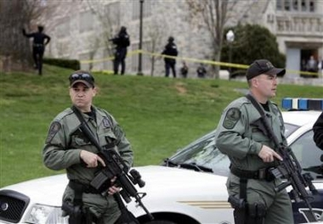
Prevention and Response: Acts of Terrorism on Campus
Part 2: Preparing for and Responding to the Threat of Terrorism on Campus

Slide 37
Campus Community Preparation & Response to Violent Threats Emergency Management Model

Slide 38
Prevention
What should the SBLE look for in detecting a possible terrorist attack?

Slide 39
Suspicious Individual Activity
Multiple identification such as driver’s licenses from different states, passports from different countries
Papers, Credit Cards, ect., with different name/addresses
Poorly made documents with misspellings or poor laminating
Blueprint, maps. And photographs of possible operational or target locations

Slide 40
Suspicious Individual Activity
Uniforms, entry badges, other work clothing
Tools and materials that are not connected to the subjects work activity
Phone book, notebook, social security numbers, credit cards that do not match the subject
Multiple money orders, money transfers

Slide 41
Suspicious Individual Activity
Multiple short term storage receipts
Multiple prepaid cell phones
Multiple ATM cards from different states and regions

Slide 42
Suspicious Items in a Residence
Little to no furniture
Police manuals, military training manuals, flight manuals
Maps, photos, diagrams, and/or blue prints of operational or target locations
Radio scanners, walkie-talkies, other communications systems
Notes:
SBLE’s should help disseminate this information to municipal and county police that may be responding to houses and businesses in the area of the school. SRO’s should make sure the members of their own department have this knowledge.

Slide 43
Suspicious Items in a Residence
Collection of personal protective equipment, chemical/biological precursor supplies
No pictures of family
No hardline telephone
Presence of radical literature
Training manuals that could relate to an attack plan

Slide 44
Suspicious Residence
Subject pays rent in cash and for blocks of time
Located on the ground floor to facilitate escape
Locate in a high traffic area
Located in a building with no security or cameras to record activity
Contains ladders, hatches, climbing apparatus for escape facilitation

Slide 45
Suspicious Residence
Trash not put out for public trash collection
Evidence that the subject rents multiple apartments
Unusual amounts of visitors in and out of the residence
Unusual chemical odors or precursor items to bomb making (To be covered in the SBLE bomb course)

Slide 46
Suspicious Items and Vehicles
Training manuals, maps, blueprints, radical literature
Cameras, videotape recorders, surveillances equipment
Precursor materials to bomb making (To be covered in the SBLE bomb course)
Rental vehicle and the person resides in the area

Slide 47
Suspicious Items and Vehicles
Vehicle parked in unusual locations
Altered license plates
Signs that the vehicle has been broken into or stolen

Slide 48
Campus Community Preparation & Response to Violent Threats Emergency Management Mode
Prevention
Mitigation
Preparedness
Response
Recovery

Slide 49
Mitigation/Preparedness
Physical Safety/Security
Cultural Safety/Security
Information/Intelligence
Communications
Emergency Management

Slide 50
What Must We Do?
Deter
Detect
Delay
Disengage*
Defeat
Lt. Col. Dave Grossman (2010)
* Steve Ramirez (2011)

Slide 51
What Do We Do
Deter
Physical Safety/Security
Detect
Behavioral Assessment, Threat Assessment, Cultural Safety/ Security, Information/Intelligence
Delay
Lock Doors, Secure Area, Single Point of Entry

Slide 52
What Do We Do?
If you feel your life is in eminent danger you may need to:
Disengage
Evacuation or Escape by any means
Defend
Police Response or Targets Fighting Back (Capable Guardians)

Slide 53
Where to Report?
Joint Terrorism Task Forces (JTTFs) are small cells of highly trained, locally based, passionately committed investigators, analysts, linguists, SWAT experts, and other specialists from dozens of U.S. law enforcement and intelligence agencies. It is a multi-agency effort led by the Justice Department and FBI designed to combine the resources of federal, state, and local law enforcement.

Slide 54
JJTF
http://www.justice.gov/jttf/
Find and make contact with your regional JTTF. They can be a one stop shop for assistance if an SBLE suspects/finds indicators of a possible terrorist threat to a school.

Slide 55
“Sheep have two speeds, graze and stampede.”
Lt. Col. Dave Grossman

Slide 56
Action Planning Exercise
What Policies, Procedures, Plans, Training, Resources do you currently have in place at your school to accomplish the following?
Deter
Detect
Delay
Disengage
Defeat
Notes:
Instructor Note: The instructor will chose from these two possible exercises:
1. lead a discussion session and make a list of the actions that can be taken in the particpant SBLEs schools to
Deter
Detect
Delay
Disengage
Defeat
(OR)
2. Break the class into groups and have them create a list of the above actions and report them back to the whole class.

